Slide 1
LAN: Learning to Adapt Noise for Efficient & Scalable Image Denoising
Team Members:
Anish Anandhan A L- 22MIS1190
Laksharaa A S – 23MIA1053
Sandheep S S – 23MIA1161

Slide 2
Motivation / Problem Statement
Problem Statement:
Deep denoising models trained on one dataset fail under unseen noise (domain shift).
Real-world noise is non-Gaussian, sensor-dependent, and signal-dependent.
Large transformer models (e.g., Restormer) perform well but are slow and resource-heavy.
Need a method that:
Adapts to new noise at test time
Works even on lightweight models
Does not require retraining or fine-tuning weights
Motivation:
Enable real-time, on-device, and edge-friendly adaptive denoising.

Slide 3
Paper Summary
Base Paper: LAN – Learning to Adapt Noise (CVPR 2024)
Key Concept:
LAN introduces a learnable noise offset (ϕ) at test time to align unseen noise with training noise.
Advantages:
No weight fine-tuning
Only adapts input (yu + ϕ)
Low computational overhead
Self-supervised (no clean images needed)
Limitations of Prior Work:
Demonstrated only on Restormer (large transformer)
Unclear if LAN works for light models like CNNs
Our Contribution:
Replace Restormer with NAFNet (lightweight CNN)
Show that LAN is backbone-agnostic and works equally well

Slide 4
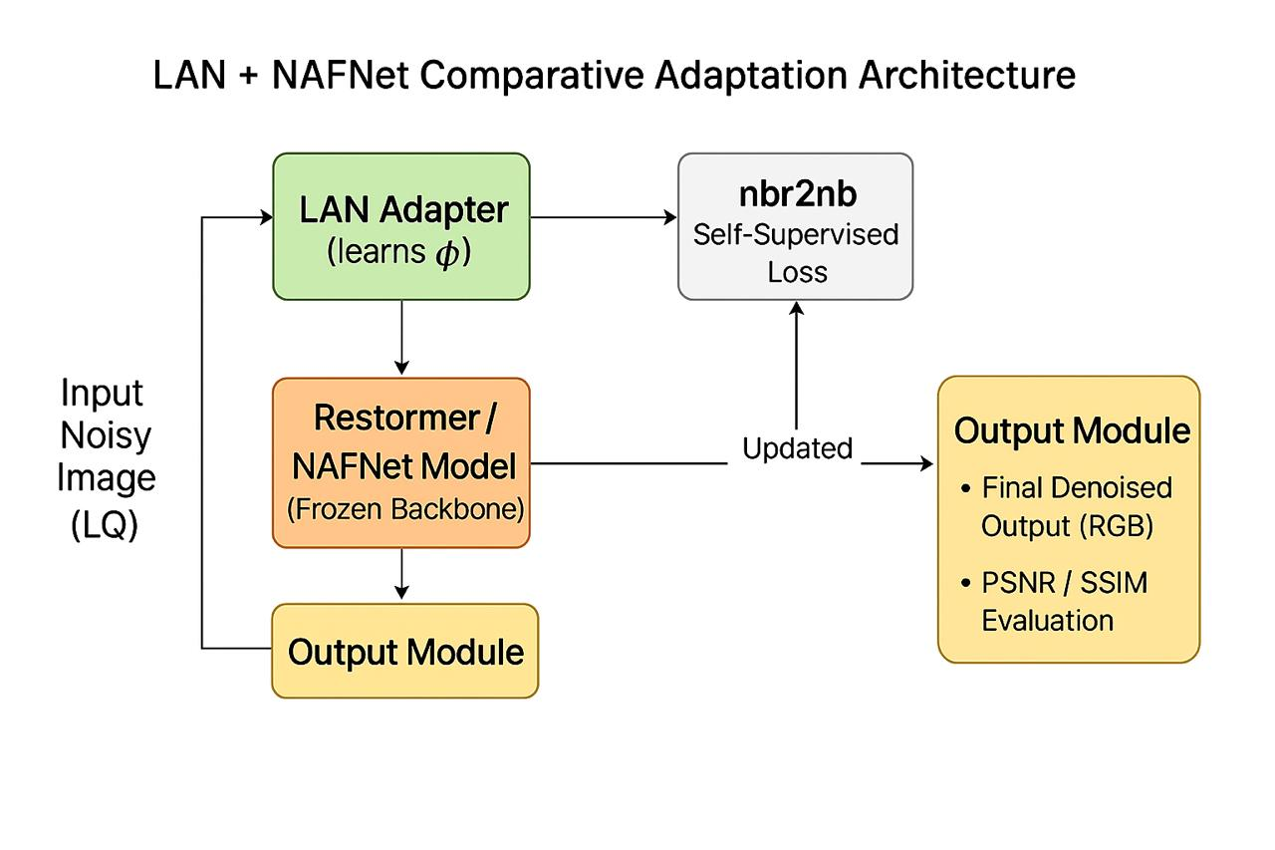
Methodology
Key Idea:
LAN adapts noise, not model weights → stable & efficient.

Slide 5
Experimental Setup
Datasets
Pretraining: SIDD — high-quality paired noisy-clean dataset.
Testing (Cross-domain): PolyU and Nam — real noise datasets with different sensor characteristics.
Adaptation Procedure
LAN performs test-time optimization by adjusting only the noise offset ϕ.
Two stochastic augmentations provide independent noisy views.
The network predicts consistent outputs across views to minimize noise mismatch.
Hyperparameters
Iterations tested: 5, 10, 20
Optimizer: Adam (learning rate = 1 × 10⁻³)
Higher iterations → slightly better PSNR but more latency.
Comparisons
Restormer vs. Restormer-LAN (heavy backbone)
NAFNet vs. NAFNet-LAN (lightweight backbone)

Slide 6
Results
Table: LAN Performance (SIDD → PolyU, 10 iterations)
Key Observations:
NAFNet-LAN ≈ Restormer-LAN performance
NAFNet is 4–5× faster
LAN boosts both models consistently
Model | PSNR ↑ | SSIM ↑ | Time (ms) ↓
Restormer-Pre | 38.10 | 0.895 | 150
Restormer-LAN | 38.80 | 0.912 | 180
NAFNet-Pre | 37.70 | 0.890 | 40
NAFNet-LAN | 38.55 | 0.906 | 50

Slide 7
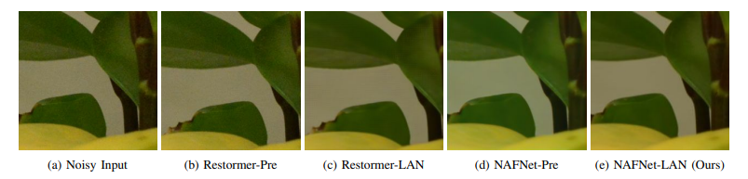
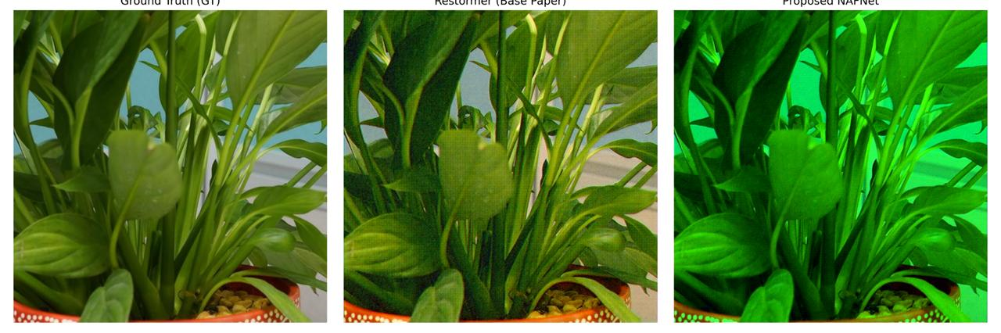
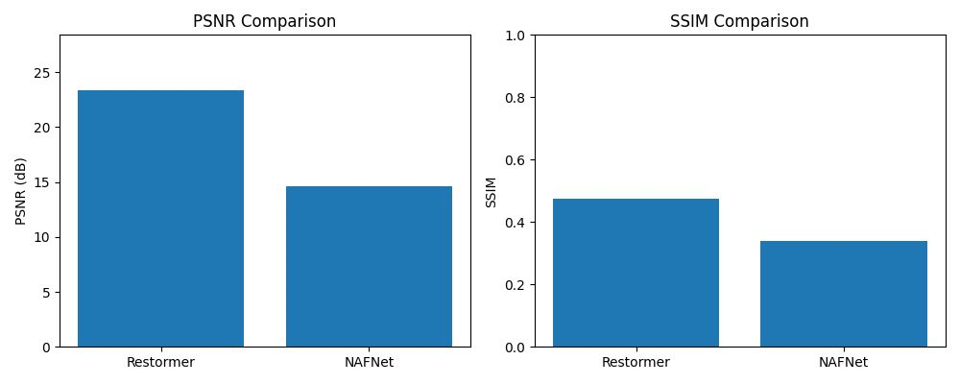
Image Results
Takeaway:
LAN improves sharpness and reduces over-smoothing
NAFNet-LAN preserves textures with minimal runtime

Slide 8
Findings & Future Enhancements
Key Findings:
LAN is backbone-agnostic
Lightweight NAFNet with LAN ≈ Heavy Restormer with LAN
LAN eliminates the need for retraining
Enables real-time, mobile, and edge-friendly adaptive denoising
Only 5–10 iterations required for convergence
Future Enhancements:
Dynamic backbone switching (Restormer ↔ NAFNet) based on device resources
Extension of LAN to video denoising with temporal consistency
Apply LAN to hyperspectral, thermal, medical, satellite images
Faster adaptation via meta-learned ϕ initialization or low-rank offset
Edge deployment in drones, AR/VR, surveillance cameras

Slide 9
THANK YOU…

